Slide 1

Alternative Risk Transfer
The future of Reinsurance?
An introduction for a discussion at the
Association Internationale de Droit des Assurances
Vth AIDA Europe Conference: Copenhagen
Thursday June 11 2015
Glenn Sexton
Consultant Equinox Global Ltd

Slide 2
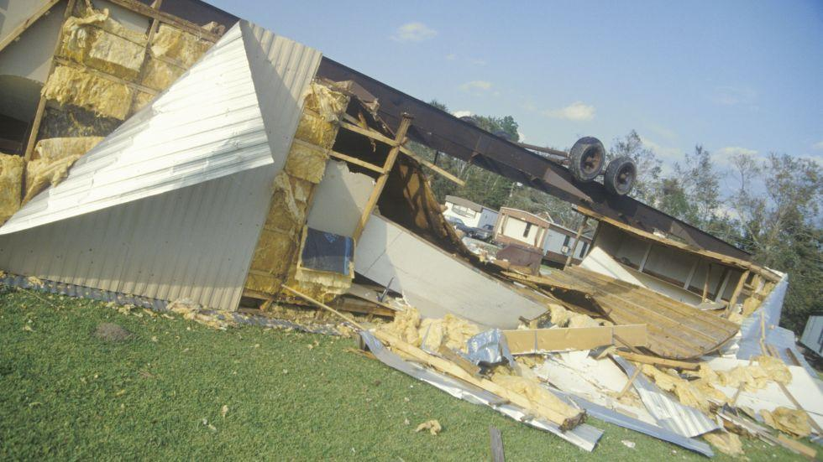
Transfer of Risk
Hurricane Andrew August 1992

Slide 3
Insurance Linked Securities
As a result of Hurricane Andrew Reinsurers saw that their capital was in danger because of frequency of severe weather events
Severity
Concentration
Duration
Legal action
Notes:
Use multiple points, if necessary.

Slide 4
Industry Loss Warranties
Based on “Market Loss” i.e. The overall loss recorded by the Market after a particular event.
The Sponsor of an ILW may not suffer direct loss or may accept a Condition that there is a loss in excess of a stated value sustained as a consequence of the insured event.
Third party indices provide the basis for definition of the “trigger” which will justify payment from the fund

Slide 5
Industry Loss Warranties
Some questions:
Does the chosen index fully represent the losses in the chosen class (e.g. covers all of the relevant area)?
If more than one index is required to cover the relevant area or class do the providers use the same methods and definitions?
Is recording consistent over the whole area?
How clear is the contract?

Slide 6
Catastrophe Bonds
First issued in mid-1990’s
Over 280 to date
Key Terms
SPV
SPI (SP Insurer)
SIV (SP Investment Vehicle)
Hurricane Andrew
(ARTEMIS website)
Counterparty
or ‘sponsor’
Premiums
Cash
SPV
Bond Investor
Return (income)
Investment from sale of notes
Collateral account
(Rated investment)
Liquidation
On maturity, pay to SPV to redeem Notes
On contingent event, pay to SPV to ‘sponsor’
Coverage
via issued securities

Slide 7
Catastrophe Bonds
Counterparty
or ‘sponsor’
Premiums
Cash
SPV
Bond Investor
Return (income)
Investment from sale of notes
Collateral account
(Rated investment)

Slide 8
Catastrophe Bonds
Some questions:
How well does the definition fit with the underlying insurance contracts?
Is there a trade-off between speed of settlement and final crystallisation of the impact of the event?
If there is a serious widespread catastrophic event how robust is the fund available to the Sponsor?
How “light” can covenants get?

Slide 9
How Did We Get Here?
It is accepted that the risk of major weather-related events is likely to increase
Wider primary insurance coverage is likely to increase the impact of widespread loss events; economic growth may increase the value of goods/services at risk
Permanent capital for (re)insurers may be provocative of “activist” investors requiring distributions or mergers

Slide 10
Discussion
The advantages and disadvantages of structures mentioned versus permanent capital
The probability of stability when returns on other investments turn positive (e.g. government bonds)
The possibility of litigation delaying payment under such structures to the extent that a Sponsor might fail following a catastrophic loss event
The general effect on premium rates for all classes

Slide 11
Disclaimer
The opinions and research in this presentation are mine alone and no other person or firm should be considered as sharing or agreeing with anything said.

Slide 12
Acknowledgements
I am grateful to record the following from which information has been drawn in preparing the above;
Artemis website
Ince & Co, solicitors
Kennedys, solicitors
Various articles in the Financial Times and the Journal of the Chartered Insurance Institute and publications of the Insurance Institute of London.

